Slide 1
Lending Club - Case Study EDA - Presentation
Contributors:
Uday kumar adavi
bibhu sundar sahoo

Slide 2
Lending Club business
Business Understanding:
Lending Club is a consumer finance company which specializes in lending various types of loans. The company receives a loan application, the company must decide for loan approval based on the applicant’s profile. Certain factors of risks are associated while making this decision.
Loss of business - Applicant is likely to pay the loan, and company is not approving the loan.
Financial Loss - Applicant may default on the loan, i.e. not pay.
Business Objective:
Improve loan approval process to balance revenue from customer who fully pay their loans and financial loss due to customers defaulting

Slide 3
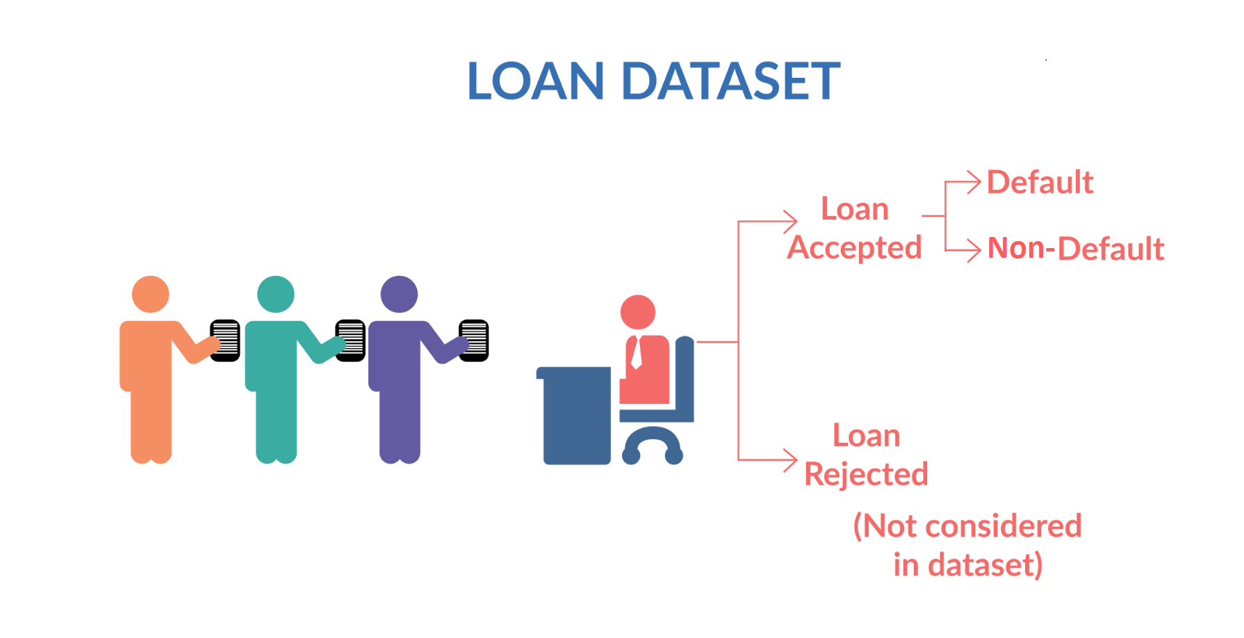
Problem statement
When a person applies for a loan, there are two types of decisions that could be taken by the company:
Loan accepted
Loan rejected
Lending Club would like for us to do an exploratory data analysis to the past loan applicant’s dataset to understand consumer attributes and loan attributes that drive loan default behavior & thereby the ability to identify risky loan applicants.

Slide 4
Structured process was followed to solve this problem
Business problem framing
Data Sourcing & understanding
Data cleaning & handling
Exploratory
Analysis - univariates
Exploratory analysis of Target variable relationships
Summary of findings, insights & recommendations

Slide 5
Data considered for the EDA
Consumer Attributes
Annual income
Employment Length
Home ownership
Debt-to-income ratio
Past delinquencies/bankruptcies
Earliest credit line open
State/Postcode
Revolving balance & utilisation
Employment title
Loan Attributes
Loan amount
Funded amount
Instalment
Interest rate
Term
Grade
Verification status
Title
Loan Purpose
Loan Status
Fully Paid
Charge-off
Default Flag
Loans for which status was Charge-off
Input variables of interest for analysis
Target variable for analysis

Slide 6
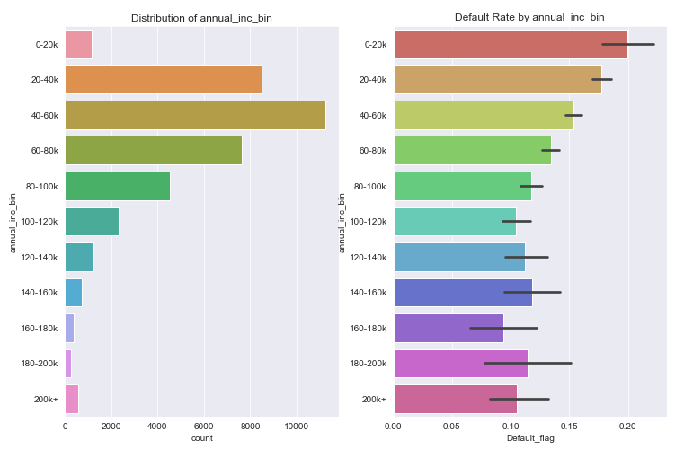
Data analysis illustration - Numerical variable example#1
Annual Income of customer
As expected lower incomes have higher default rate, atleast until 80k
And then onwards with higher annual income the default rate is on lower side

Slide 7
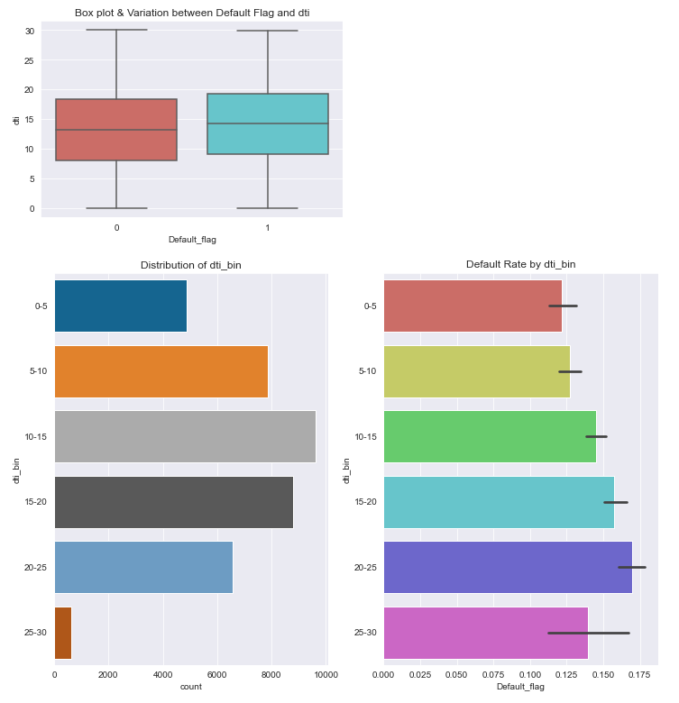
Data analysis illustration - Numerical variable example#2
Debt to income ratio of customer
As expected, higher the DTI, higher the default rate
Thus it's risky to offer loan to customers with high DTI, especially >10

Slide 8
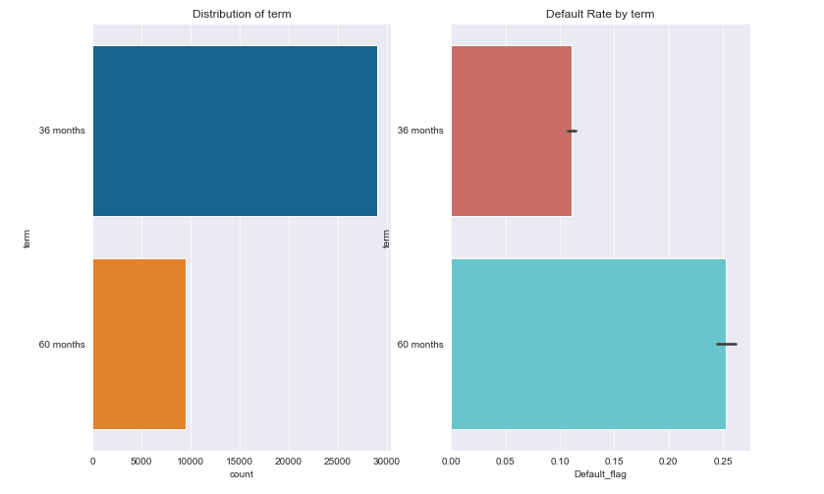
Data analysis illustration - Categorical variable example#1
Term of loan
Clearly, '60 months' term group has much higher default rate than 36 months

Slide 9
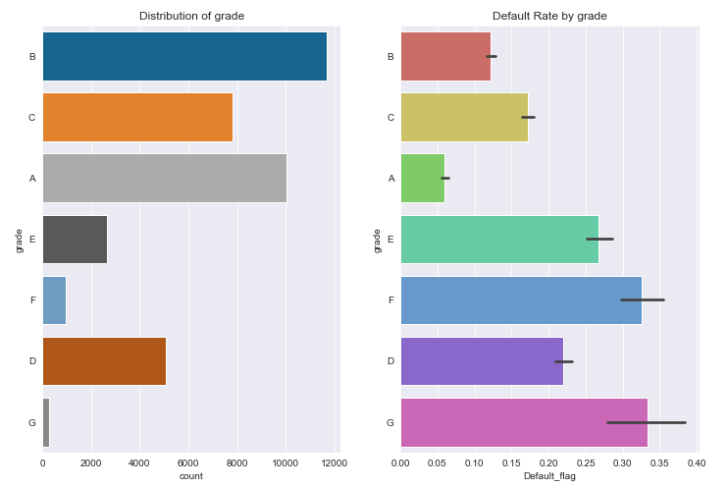
Data analysis illustration - Categorical variable example#2
Grade of loan
It is unclear how the grade and subgrade are calculated, but there is definitely a positive correlation between default rate and grade, subgrade
The lending club grade and sub grade are related. The grades are in an ordinal scale where starting scale like A1,B1 have lower default rate which further increases by the end of the ordinal scale. Lower alphabet grade(A,B...), subgrade(A1,B1) have lower default rates

Slide 10
Key findings & recommendations
Any loan applicant with annual income less than 100K should go through heightened scrutiny
It's risky to offer loan to applicants with higher DTI and Loan to income ratio.
The higher default rate in high interest rate category evidently says it's risky to offer high interest loan to customers.
Any loan applicant who has a credit age below 5 years should go through heightened scrutiny.

Slide 11
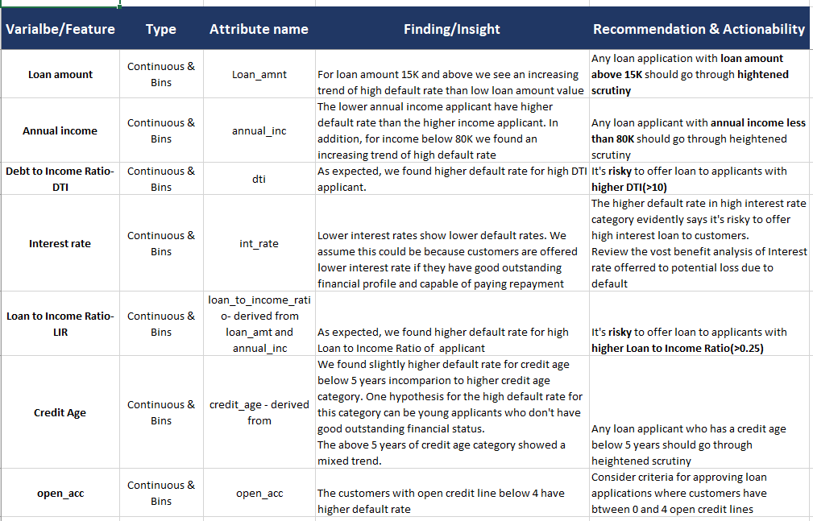
Summary of analysis across all data -1

Slide 12
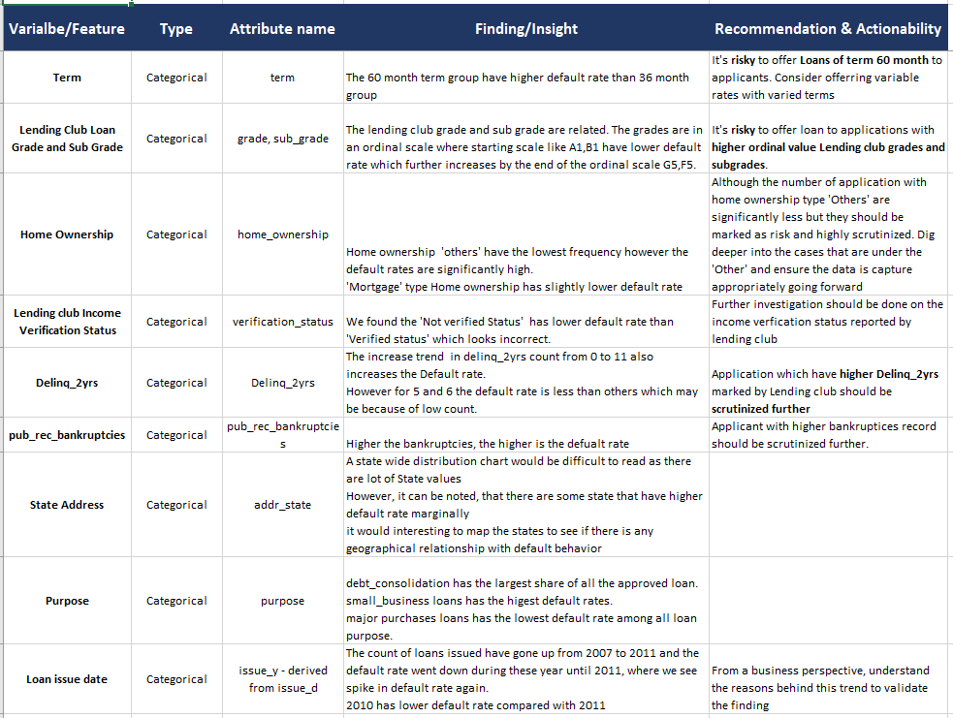
Summary of analysis across all data -2

